Slide 1
Deutsch als fremdsprache

Slide 2
Why German?
Lets see a few interesting facts about the country
Deutschland –
Known for their automobile industry (car production) – world’s top car manufacturers – Volkvagen, Mercedes, BMW, Audi, Porsche
German universities offer world –class education at lowest or rather no tuition fees at public schools/ universities. The cost of living is also comparatively lower compared to other popular countries for Masters .
- about the language
1. Most widely spoken as mother language in the Europe
- official language in 7 countries – Switzerland, Luxemburg, Belguim etc
2. English and German share 60% of their vocab (Eng and French – 27%)
3. Known for its longest words. (79 letters)

Slide 3
German dialects
1. Hoch Deutsch (High German / Standard German) Used in southern side of the country and also in many countries. Most commonly taught in schools, used in TV and news. | 4. Schweizer Deutsch (Swiss German) Differs a lot from others Influenced by French and Italian Official language
2. Plattdeutsch / Niederdeutsch (Low German) Used in northern and eastern part of Netherlands. Pronunciations and writing form is quite similar to Hoch Deutsch. | 5. Mittel Deutsch (Middle German) Used all across middle of the country including Dusseldorf, Cologne, Frankfurt and Berlin, also other most German cities except Hamburg and Munich
3. Oberdeutsch (Bavarian / Upper German) Differs from standard German – both pronunciations and spellings. Even natives find it difficult to understand | 6. Ostereichishes Deutsch (Austrian German) Differs slightly from others Same grammar but unique vocabulary.

Slide 4
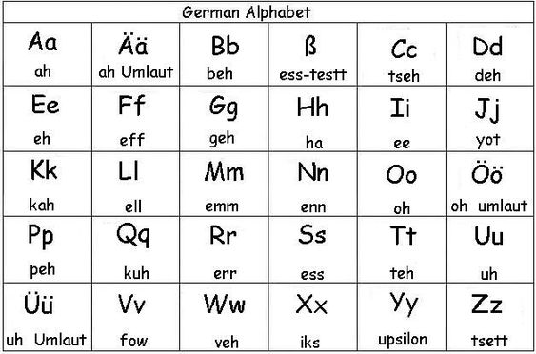
Die BUCHSTABEn – Letters
ä is pronounced as ‘a’ as we do in bay
ü is pronounced as ‘ew’ as we do in chew
ö is pronounced as ‘yo’
β is pronounced as ‘ss’

Slide 5
Pronunciation keys
1. e (in the end of word) = “a”
Ex. - Junge , Hilfe, Sprache etc.
2. ie = “ee”
Ex. - Sie, Liebe, Spiele etc.
3. ei = “eye” as we say in “Hi”
Ex. - Backerei, Heimat, meine etc.
4. Ä = “Aey”
Ex. - Ähnlich, Zähne, Später etc.
5. Ü = “you”
Ex. – Natürlich, Über, Küche
Few more are, Z = Ch, g = sh, j = y , v = f, ch = kh, s = z
( go to K.B Seite nummer – 10, 11)

Slide 6
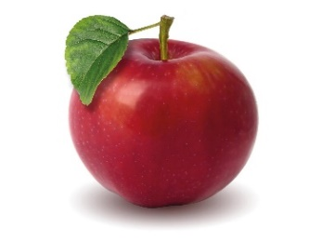
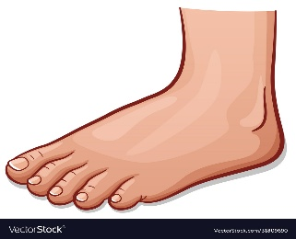
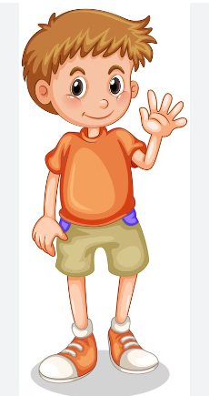
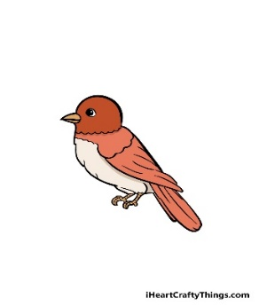
Practise – die aussprache (pronunciation)
Der Apfel = aapfel
Der Fuß = Fuss
Der Junge = Boy
Der Vogel = Fogel
Spell the below words
P U N E T A N A Y A A M A Z O N K Ü C H E
B E R L I N V I E L C H R I S U S A
Read the below words
Die Tür , Der Tisch , Der Körper, Die Ärztin , Der Zug, Das Volkswagen

Slide 7
Greetings and farewells
Good morning = Guten Morgen
Good afternoon/ hello (informal) = Guten Tag
Good evening = Guten Abend
Good night = Gute Nacht
Goodbye (formal) = Auf Wiedersehen
Bye (informal) = Tschüs
How are you = Wie geht es Ihnen? (Formal)
Wie geht es dir? (Informal)
Fine, thank you = Danke gut
I’m good = Es geht mir gut.

Slide 8
What is your name? = Wie heiβen Sie? (formal)
Wie heiβt du? (Informal)
My name is.... = Ich heiβe __________
Nice to meet you = Nett, Sie kennen zu lernen
Yes/no = ja/nein
Thank you, thank you very much = Danke, Danke sehr
You’re welcome = Bitte sehr
Please = Bitte
Excuse me = Entshuldigung
Pardon = wie Bitte? / Verzeihung
I can’t speak german = Ich kann nicht Deutsch sprechen
Do you speak English? = Sprechen Sie Englisch?
I don’t understand you = Ich verstehe Sie nicht.
Could you repeat please? = Können Sie bitte das Wiederholen
Speak slowly please = Sprechen Sie bitte langsam

Slide 9
Danke!
Auf Wiedersehen !

